Slide 1
18CSE390T
Computer Vision
S6-Normalized cuts

Slide 2
Normalized cuts
The normalized cut criterion measures both the total dissimilarity between the different groups as well as the total similarity within the groups.
The key point is that image partitioning is to be done from the big picture downward, rather like a painter first marking out the major areas and then filling in the details.
Minimizing normalized cut exactly is NP-complete, even for the special case of graphs on grids
An approximate discrete solution can be found efficiently

Slide 3
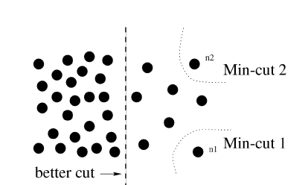
MINCut problem
Minimum cut criteria favors cutting small sets of isolated nodes in the graph

Slide 4

Normalized cut
where assoc(A,V) is the total connection from nodes in A to all nodes in the graph

Slide 5

Normalized Association
Measure for total normalized association within groups for a given partition:

Slide 6
NAssoc vs NCut
A direct conclusion:
  NCut(A,B) = 2 – Nassoc(A,B)
Ncut is normalized measure of disassociation
Minimizing Ncut is equivalent to maximizing association

